Slide 1
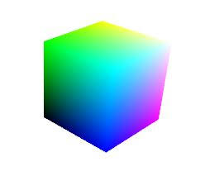

OpenGL Shaders Presentation
-by Ayush Pravin

Slide 2

Introduction to OpenGL
What is OpenGL?
OpenGL, short for Open Graphics Library, is a cross-platform, open-source API (Application Programming Interface) used for rendering 2D and 3D vector graphics, enabling hardware-accelerated graphics rendering by interacting with a graphics processing unit (GPU).
It's typically used to interact with a GPU to achieve hardware-accelerated rendering.
Why use OpenGL?
Cross-platform compatibility (Windows, Linux, macOS).
Industry standard for real-time rendering in games, simulations, CAD software, etc.
Provides flexibility through shaders and modern rendering techniques.

Slide 3

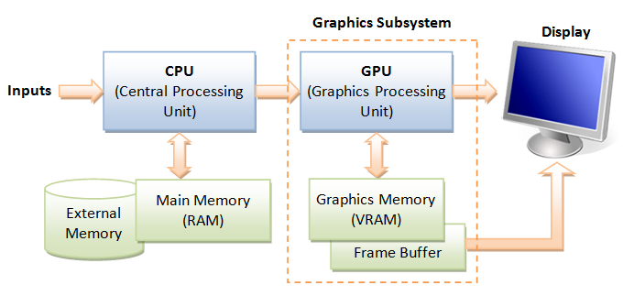
Introduction to OpenGL
How does it work?
GPU: Graphics Processing Unit
OpenGL acts as a bridge between your application and the GPU, allowing developers to leverage the GPU's power for efficient graphical computations.
GPUs are optimized for parallel processing, which makes them ideal for handling the large number of calculations required for rendering complex scenes.

Slide 4
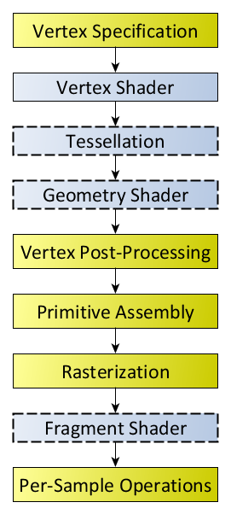
OpenGL Rendering Pipeline
What is Rendering Pipeline?
It is the sequence of steps that OpenGL takes when rendering objects.
It is initiated when we perform a rendering operation.
The blue boxes are programmable shader stages, i.e they are optional.
Programmable shader stages allow developers to customize rendering behavior for unique effects.
Diagram of the Rendering Pipeline.

Slide 6
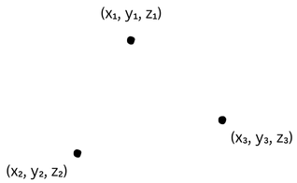
OpenGL Rendering Pipeline
Vertex Specification
The process of vertex specification is where the application sets up an ordered list of vertices to send to the pipeline. These vertices define the boundaries of a primitive.
Primitives are basic drawing shapes, like triangles, lines, and points.
It deals with a number of objects like Vertex Array Objects and Vertex Buffer Objects.
Vertex Array Objects define what data each vertex has, while Vertex Buffer Objects store the actual vertex data itself.
A vertex's data is a series of attributes. Each attribute is a small set of data that the next stage will do computations on.

Slide 7
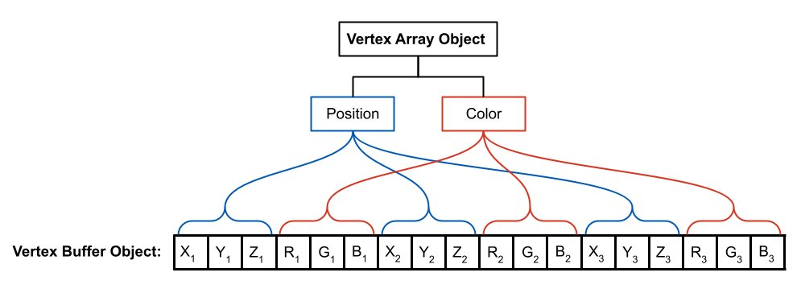
Attribute data is entirely arbitrary; the only meaning assigned to any of it happens in the vertex processing stage.

Slide 10
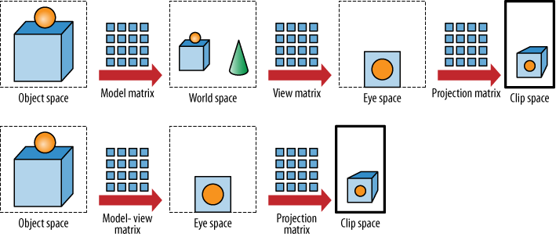
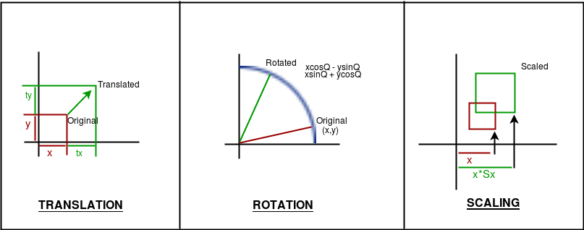
OpenGL Rendering Pipeline
Vertex Shader (Not Optional, Part of Vertex Processing)
Vertex shaders take vertex data as input, which typically includes position, color, texture coordinates, and other attributes.
They apply transformations to this data to convert the vertex's position from object space to clip space, which is necessary for rendering on a 2D display

Slide 13
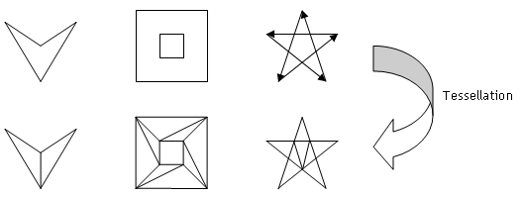
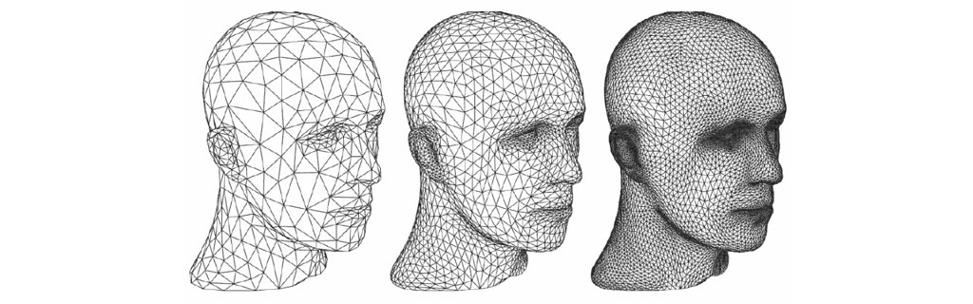
OpenGL Rendering Pipeline
Tessellation
In this stage primitives are tessellated i.e. divided into smoother mesh of triangles.
If there are no subsequent vertex processing stages, vertex shaders are expected to fill in this position with the clip-space position of the vertex, for rendering purposes.

Slide 16
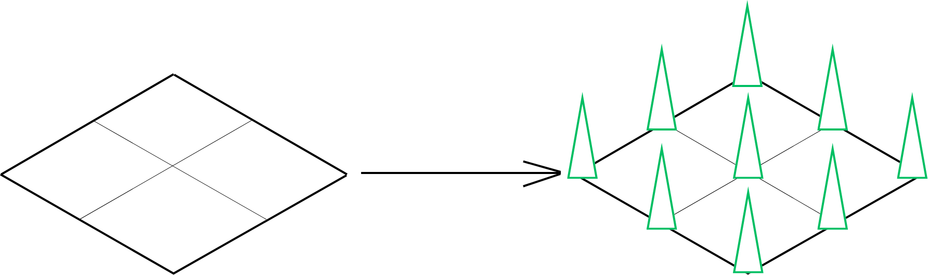
OpenGL Rendering Pipeline
Geometry Shader
One of the key features of geometry shaders is their ability to generate new geometry. For instance, they can take a triangle as input and output additional triangles or other shapes (like points or lines) based on the original input.
Geometry shaders can increase (amplify) or decrease (de-amplify) the amount of geometry being processed. This means they can discard certain primitives or emit multiple new ones from a single input primitive

Slide 19
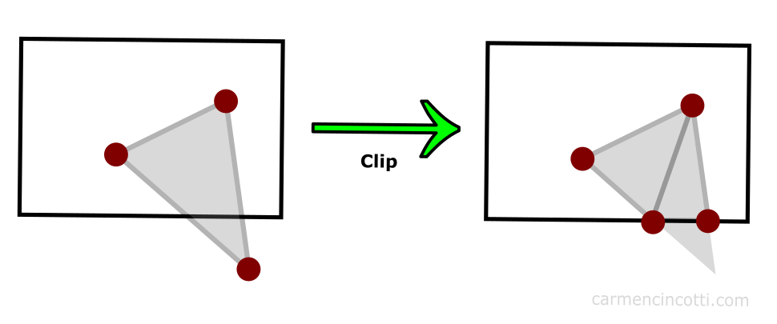
OpenGL Rendering Pipeline
Vertex Post Processing
Any vertices outside the view frustum (the region visible to the camera) are discarded.
The vertices are transformed from homogeneous coordinates (used during projection) to normalized device coordinates.
The normalized device coordinates are scaled and offset to fit the dimensions of the screen or viewport.

Slide 22
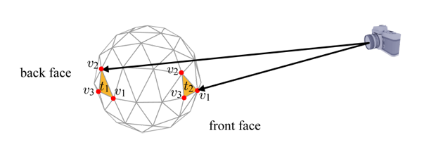
OpenGL Rendering Pipeline
Primitive Assembly
Vertices processed in earlier stages are grouped based on the drawing mode specified by the application.
The winding order of the vertices (clockwise or counterclockwise) is determined. This is used to distinguish between front-facing and back-facing primitives.
Back-facing primitives can be culled (discarded) at this stage to improve rendering efficiency
Primitives that intersect the boundaries of the view frustum are clipped.

Slide 25
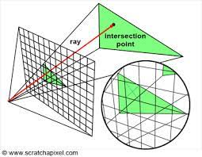
OpenGL Rendering Pipeline
Rasterization
First, primitives are projected onto the 2D screen space.
The rasterizer determines which screen pixels (also called fragments) fall within the bounds of the primitive. This process involves sampling and interpolation:
Sampling: Checks pixel positions to see if they fall inside the primitive.
Interpolation: Calculates values like texture coordinates, normals, and colours for each pixel by interpolating data from the primitive's vertices.
the rasterizer applies z-buffering (depth testing) to handle overlapping objects in the 3D scene

Slide 28
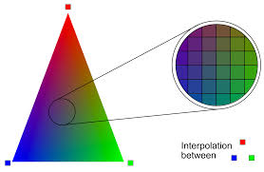
OpenGL Rendering Pipeline
Fragment Shader
The fragment shader calculates the color of each fragment based on various inputs such as:
Interpolated vertex attributes: Colors, normals, texture coordinates, etc., passed down from the vertex shader and rasterizer.
Lighting Effects: Simulating light interactions (diffuse, specular, ambient lighting) to achieve realistic shading.
Textures: Applying image-based details to fragments by sampling texture maps.
The fragment shader can compare the fragment's depth value to the depth buffer to create shadow effects or ensure fragments behind others are discarded (depth testing).
It handles transparency by computing how the fragment blends with underlying pixels.

Slide 31
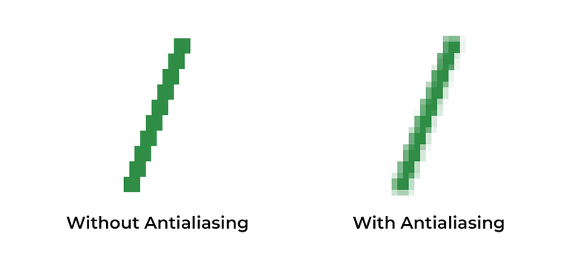
OpenGL Rendering Pipeline
Per-Sample Operations
In techniques like MSAA(Multi-Sample Anti-Aliasing), each pixel is divided into multiple samples, which represent subregions of the pixel. This allows for more accurate rendering of edges and finer details.
For transparent objects or overlapping primitives, per-sample ordering ensures the correct depth and blending operations are performed for each individual sample.
By applying depth and color calculations per sample, sharp edges are smoothed out more effectively, reducing aliasing artifacts

Slide 33
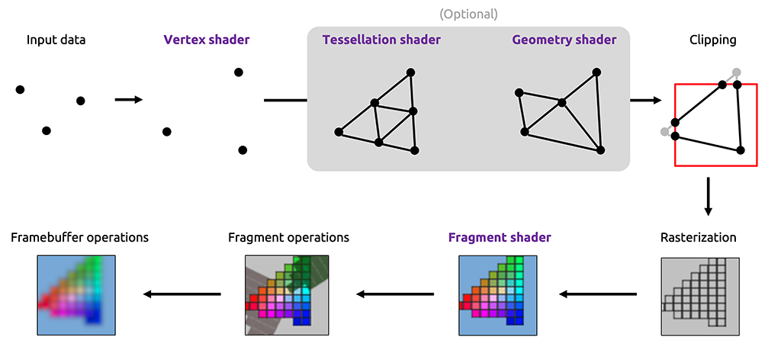

Slide 34
OpenGL Shading Language (GLSL)
It is a high-level programming language specifically designed for writing shaders that run on graphics processing units (GPUs).
It is used in conjunction with OpenGL, It allows developers to create visually stunning effects like lighting, shadows, textures, and animations.
Here are the main types of GLSL shaders:
Vertex Shader
Geometry Shader
Fragment Shader
Compute Shader
GLSL syntax is similar to C and supports features like variables, functions, and control structures.

Slide 35
OpenGL Shading Language (GLSL)
Compute Shader
a type of shader in GLSL designed for general-purpose computations on the GPU, outside the traditional graphics rendering pipeline.
Compute shaders utilize the GPU’s parallel architecture by dividing the workload into smaller chunks processed concurrently by workgroups.
They can access and manipulate GPU buffers (e.g., textures, buffer objects) and shared memory, enabling efficient data communication between GPU threads.
Unlike vertex, fragment, or geometry shaders, compute shaders do not directly contribute to rendering graphics. Instead, they focus on tasks like image processing, physics simulations, and data analysis.

Slide 36
Advanced Shader Techniques
HDR Lighting (High Dynamic Range)
It captures a wider range of light intensities, allowing for more realistic and vibrant scenes.
Brightness and color values are stored in a floating-point framebuffer to avoid clamping between 0.0 and 1.0.
Used in games and simulations to create realistic lighting effects, such as sunlight streaming through windows or glowing neon signs.

Slide 37
Advanced Shader Techniques
Post-Processing Effect
These effects are applied after the scene is rendered to enhance visuals or create stylistic effects.
common Techniques:
Bloom: Simulates light bleeding from bright areas, creating a glowing effect.
Motion Blur: Adds a sense of speed by blurring moving objects.
Depth of Field: Mimics camera lens behavior by blurring out-of-focus areas.
These effects are typically implemented using fragment shaders that operate on the final rendered image.

Slide 38
THANK YOU!

